Slide 1

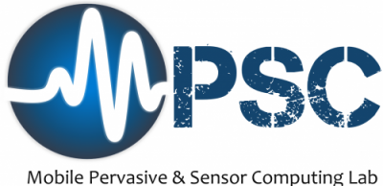
CamSense: A Camera-Based Contact-less Heart Activity Monitoring
Zahid Hasan, Sreenivasan Ramasamy Ramamurthy, Nirmalya Roy
Department of Information System, UMBC
Date: 12-16-2021

Slide 2
Overview
Background
Problem Statement
Solution
Dataset
Methodologies
Result
Conclusion
Q/A

Slide 3
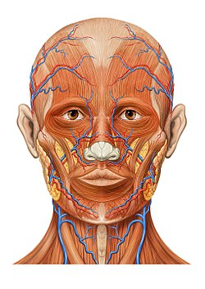
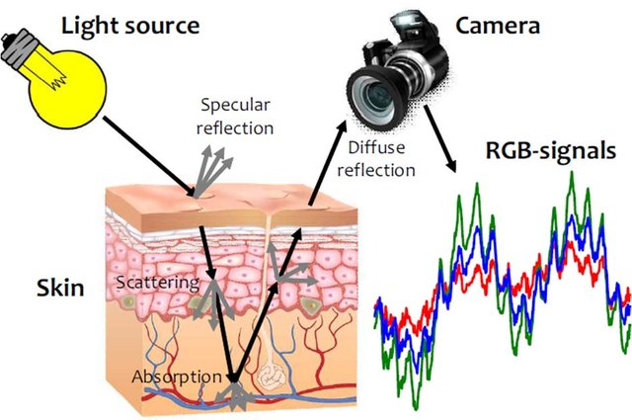
Remote Photoplethysmography (PPG)
PPG: Measurement of volumetric blood variation in the microvascular bed of tissue
Impacts: Non-invasive, contain heart activities
Principle: Blood volume impacts skin reflectivity
Light Source
Camera
Remote PPG: PPG in contactless setting using regular video cameras.
Impacts: Contactless, availability of video sensors, alternative to wearable PPG, low-cost
Principle: Proximal video sensors encode the skin tissue blood volume variation (heart activity) by picking the diffuse reflection from skin
Speculation Reflection
Diffuse Reflection
RGB-Signal
Skin
Notes:
PPG is synchronized with the hearts blood pumping

Slide 4

Challenges
Diffused reflection
Goal: Extraction of diffused signal (PPG information) from video
Captured diffusion signal depends on
Sensors, Skin color, Modality, Distance, Lighting, Subjects condition, motion, movements etc.
Target PPG are usually form limb sensors
The alignment issues across multiple data collections and sensor properties
Changes the target randomly for each data
Two implicit stages
Defining Data-driven learning objective
Data alignment issues to combine dataset
Consecutive frames
Target
PPG
Random shift between the facial PPG and captured sensor PPG in a typical rPPG data

Slide 5
Related Work
Deep Learning (DL)
Showed their early success in rPPG [3]
Learning from raw data
Automatic feature extraction
End-to-end setup
Adaptability for new environments
Implicit function approximation
Requires clean data for end-2-end setting in supervised learning
Data hungry, and computation complexity
Signal processing
Filter based [1]
Signal Decompositions [2]
Aim for the implicit rPPG
Requires Heuristic assumptions
Not adaptive

Slide 6
Data Alignment Problem
Two frame sequence has similar implicit facial PPG profile (diffused signal)
Consecutive frames
Consecutive frames
Example of Shape, and shift due to the sensor variation across multiple data collection time
Random phase shift and shape variation
Due to target sensor type, placement location variations
Wrist or finger placement
Exposed vein for PPG
One projection head requires to aim multiple objectives
Getting implicit PPG (common for all)
mapping implicit PPG to sensor target (Depends on target data)

Slide 7
Assumption behind Multitask learning
Exploit task commonalities
Shared tasks
Implicit PPG extraction
Shared parameters
Individual tasks
Target senor/signal heterogeneity
Individual heads
Shifting and scaling
Joint optimization
Learning from multiple data source simultaneously
Implicit
Consecutive frames
Target
PPG

Slide 8
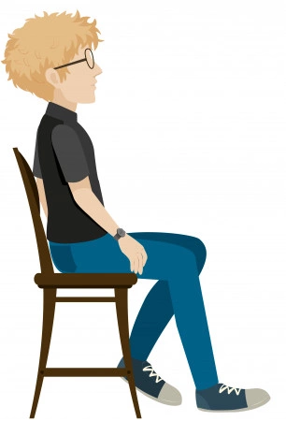
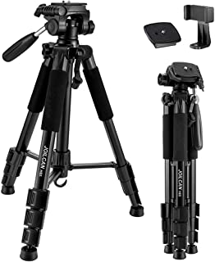
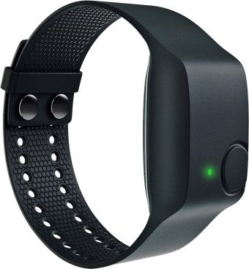
Proposed Solution
DL based approach
Aiming wearable target
Removing feature dependency
End-2-end architecture
Regression problem (Novelty)
Reconstruction of total PPG
HR information
Interpretation of the results
Three rPPG approaches
Personalized Model: Single Environment
Multitask learning (MTL): Network to relax the data alignment
Transfer Learning: Quick adaptation
During Test/Application
CamSense Model, θ
Predicted PPG
Input raw
Video from DSLR
Loss
Update model Parameter
Target PPG
Empatica
PPG
Notes:
Environment: Sensors (wearables/cameras), skin colors,
Based on our observations we propose three setup to extract rPPG

Slide 9
Methodology Overview
Input
Preprocessing
Shared Network
MTL Head
Personalized Model
FC 1
Raw Video Input
Crop,
Reshape, Normalize
100x100x40
32
64
64
96
1
64
1
64
512
512
3
3
FC 2
5
5
2
2
FC n
Legends:
Input
Output FC
CNN + BN + ReLU + Max-Pooling
Concatenation + Global average Pooling
Fully Connected Layer
s
Max Pooling layer with stride s
k
16 channel CNN+ BN +ReLU with kernel k

Slide 10
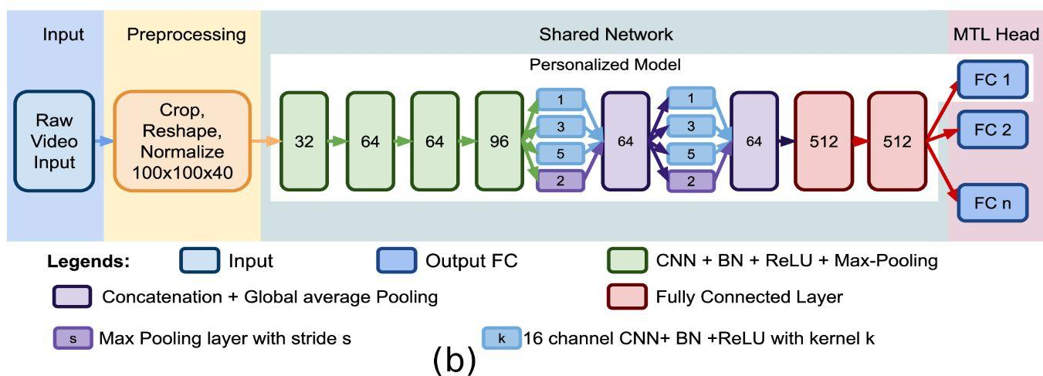
Data Preparation
Raw video input
Take 40 consecutive green frames
Covers one cycle least
Normalize the frames
Reshape the frame

Slide 11
Personalized Model
Trained with single setting
One person
Single head
Not scalable
Less generalized
Input
Preprocessing
FC 1
Raw Video Input
Crop,
Reshape, Normalize
100x100x40
32
64
64
96
1
64
1
64
512
512
3
3
5
5
2
2
P1
Input
Target

Slide 12
Multitask Model
Each head corresponds to different setting
Utilizes the task commonalities
Incorporate annotation and senor variations
Hard parameter sharing
Unscalable head numbers
Input
Preprocessing
Shared Network
MTL Head
FC 1
Raw Video Input
Crop,
Reshape, Normalize
100x100x40
32
64
64
96
1
64
1
64
512
512
3
3
FC
5
5
2
2
FC n
P1
Input
Target
Pn
Input
Target
Notes:
Mutation behind th emodesls

Slide 13
Transfer Learning
Utilization of learned representation
Minimal labels for new environments
Fine tune with small labeled section
Input
Preprocessing
Transferred Weights
Fine Tune
Raw Video Input
Crop,
Reshape, Normalize
100x100x40
32
64
64
96
1
64
1
64
512
512
3
3
FC 1
5
5
2
2
P1
Limited Input
Target (fine tune)

Slide 14
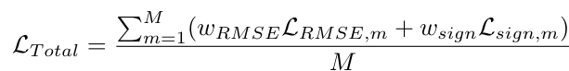
Network Optimization
Loss function:
Weighted sum of the pointwise MSE and sign-agreement loss
Optimizer: Adam
Xavier weight initialization (Personalized and MTL)
Loss curve monitor
Intermediate filter visualization
Notes:
Experimented with different initialization

Slide 15
Dataset
Two publicly available dataset
MERL [4]
RGB, RGB-demosaiced, NIR
UBFC-rPPG [5]: RGB
Collected dataset
MPSC-rPPG dataset: RGB
8 subjects (2.5 hours)
DSLR videos
Corresponding PPG (Empatica E4)
Angle, distance, lighting, skin variations
Facial Video
DSLR
Wrist Wearable Empatica E4
Target PPG
MPSC-rPPG data collection setup
Notes:
MPSC-rPPG on par with the public dataset

Slide 16
Experiments
Personalized Model
3 Modalities (MERL and MPSC dataset)
Multitask learning
3 Modalities (3 dataset)
Transfer Learning:
3 Modalities
Intra-modal transfer
RGB to RGB, NIR to NIR and so on
Intermodal transfer
RGB to NIR, NIR to RGB, and so on
Baseline Model
Personalized / MTL model
*Code links
Notes:
Across dataset transfer

Slide 17
Results
Metrics
MSE loss
Phase and peak matching
Experiments and their results
Explanation of the network behaviors
Test result on the individual experiments.
Left-out dataset
Notes:
Result on the separated test data.

Slide 18
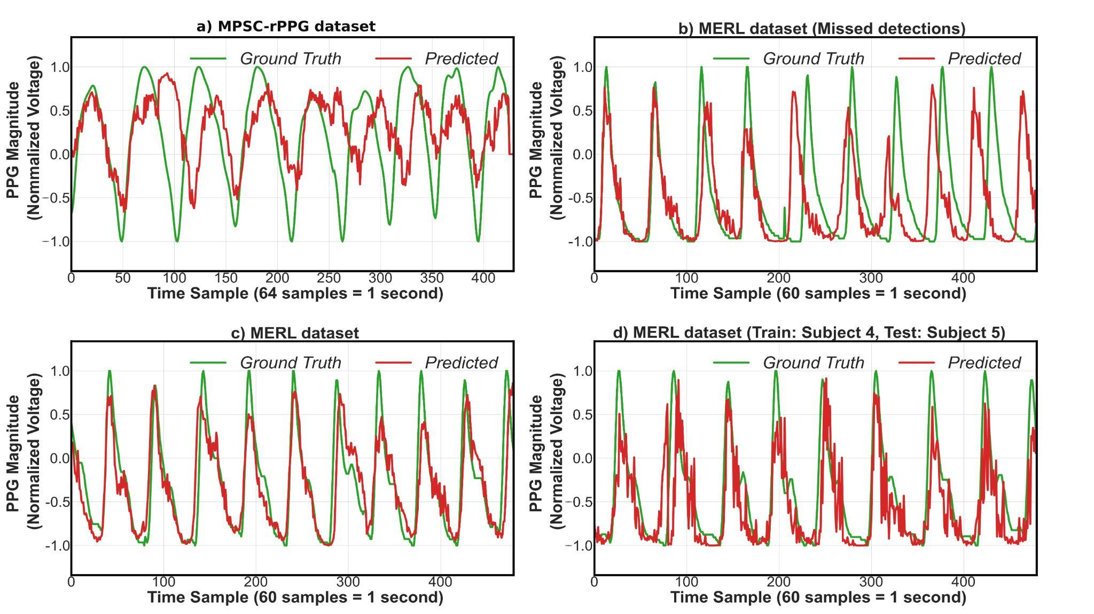
Results
Compatible with different sensors
Generalization
Notes:
Personalized
Personalized
Multitask model
Result on different subject (personalized model)

Slide 19
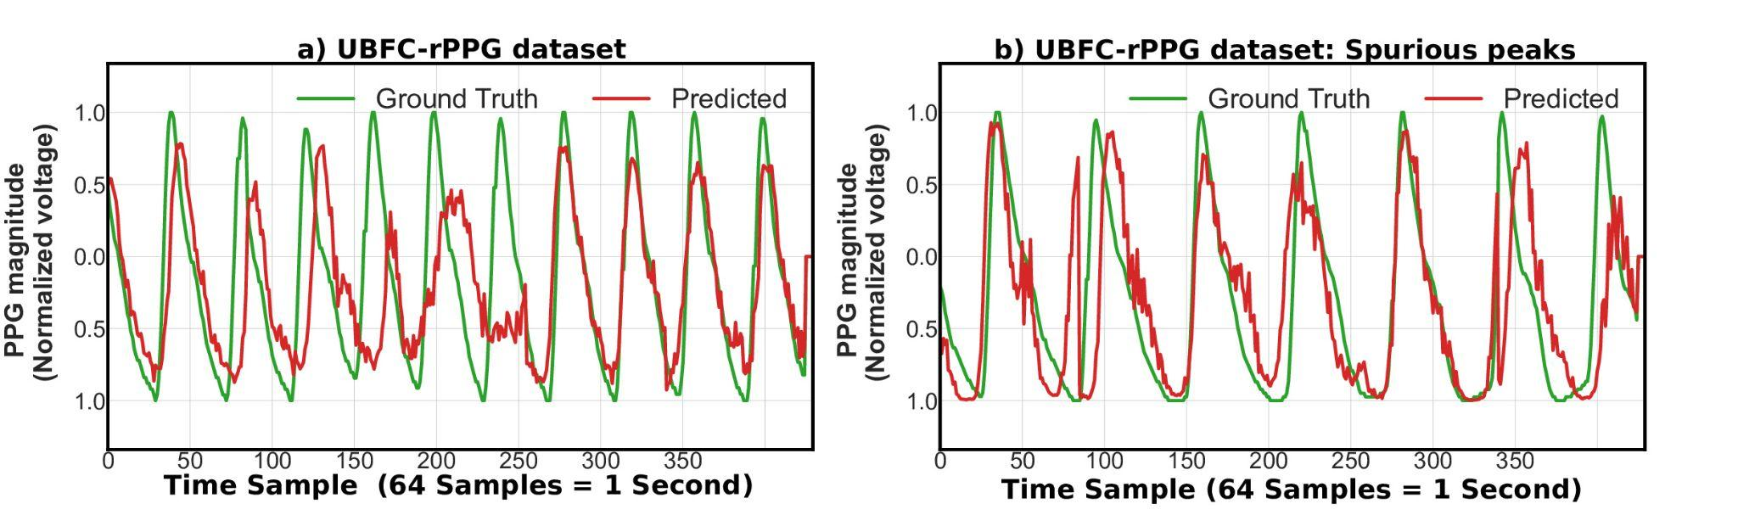
Results
Interpretation
Intermediate filtering
Design choices (Ablation study)
Importance of loss
-
Missed Peaks but recovered
-
-
Successful adaptation to UBFC
-
-
-
Notes:
Camera went out of focus for seconds.
What we are trying to say

Slide 20
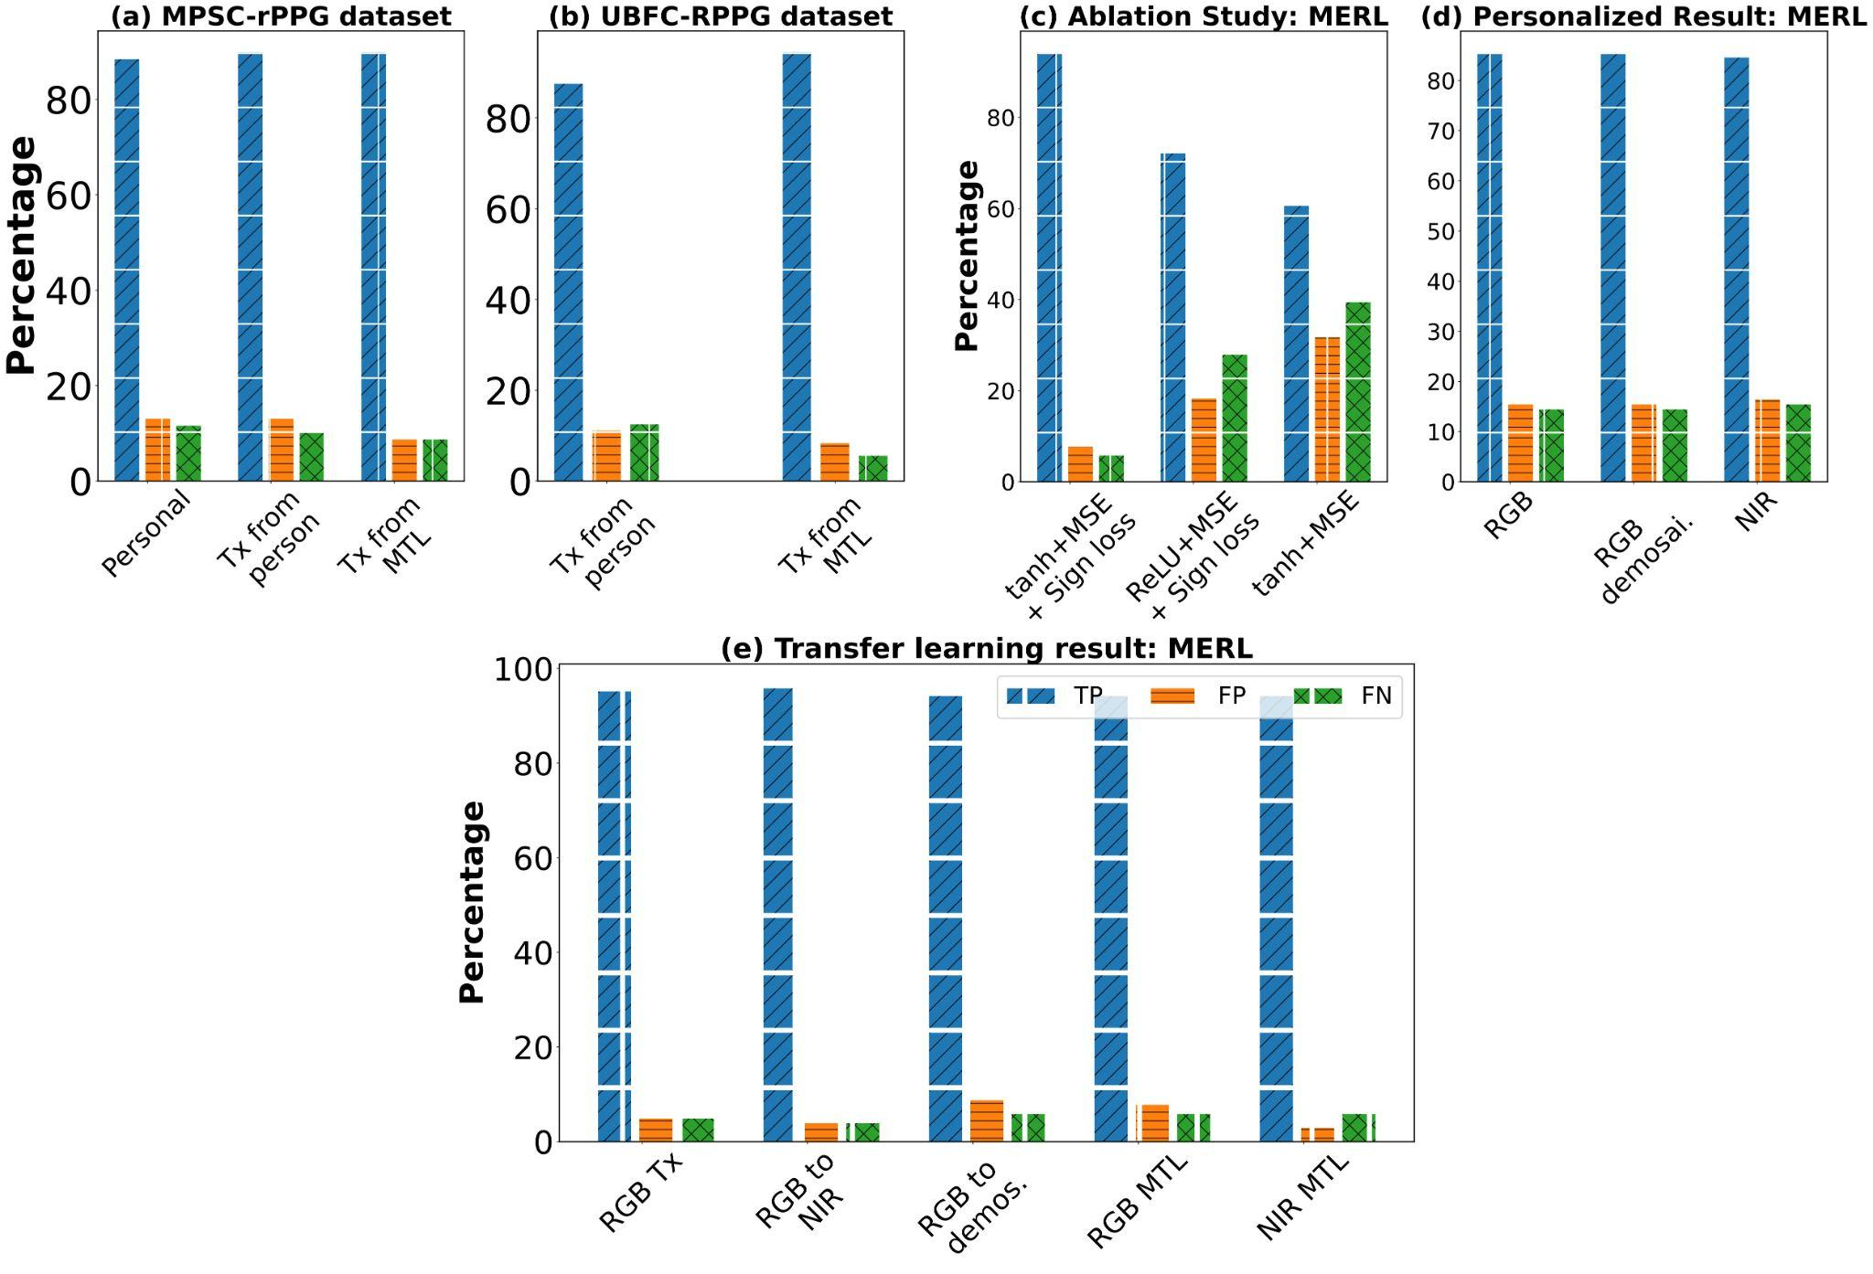
Result Summary
Validation of our Design Choice
Result on all Modalities shows generalization
Transfer from MTL works better
Notes:
UBFC totally new dataset

Slide 21
Result Summary
Result on Intermodal transfer
(Adaptive with different modalities)

Slide 22
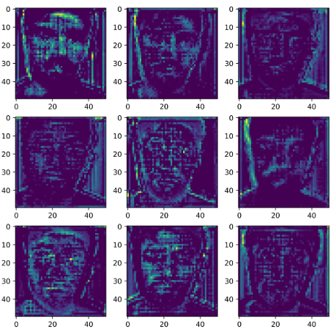
Discussion
Model behaviors
Intermediate filter focuses on face
Continuous output provide local failure and success
Our design choice enhance system performance.
Drawbacks
Requirement of calibrated labeled data
Scalability of the MTL setup
System Flaws: Relative Motion and distances (8 feet).
Future direction
Learning the implicit rPPG from raw videos without label
Enabling edge-device implementation of CamSense works.
Attention on the exposed skin

Slide 23
Conclusion
Proposed a novel data-driven approach to extract rPPG
Proposed three architectures
Validated with three modalities (three dataset)
Utilized the learned representations
Analyzed detail model performance and design choices
Proposed a new rPPG dataset
MPSC-rPPG dataset (one of the largest RGB collection)
Open-source the data*
*Dataset Link
Notes:
Reproducible results.

Slide 24
Acknowledgement
Generous Volunteers for their kind participation
This research is supported by NSF CAREER grant 1750936, U.S. Army grant W911NF2120076, ONR grant N00014-18-1-2462, and Alzheimer’s Association grant AARG-17-533039.

Slide 25

Thank you
Questions?
Contact Information:
Zahid Hasan
Email: zhasan3@umbc.edu
Project Website: https://github.com/mxahan/project_rppg

Slide 26
References
[1] Verkruysse, Wim, Lars O. Svaasand, and J. Stuart Nelson. "Remote plethysmographic imaging using ambient light." Optics express 16, no. 26 (2008): 21434-21445.
[2] Poh, Ming-Zher, Daniel J. McDuff, and Rosalind W. Picard. "Non-contact, automated cardiac pulse measurements using video imaging and blind source separation." Optics express 18, no. 10 (2010): 10762-10774.
[3] Huynh, Sinh, Rajesh Krishna Balan, JeongGil Ko, and Youngki Lee. "VitaMon: measuring heart rate variability using smartphone front camera." In Proceedings of the 17th Conference on Embedded Networked Sensor Systems, pp. 1-14. 2019.
[4] Nowara, Ewa Magdalena, Tim K. Marks, Hassan Mansour, and Ashok Veeraraghavan. "Sparseppg: Towards driver monitoring using camera-based vital signs estimation in near-infrared. In 2018 IEEE." In CVF Conference on Computer Vision and Pattern Recognition Workshops (CVPRW), pp. 1353-135309. 2018.
[5] Bobbia, Serge, Richard Macwan, Yannick Benezeth, Alamin Mansouri, and Julien Dubois. "Unsupervised skin tissue segmentation for remote photoplethysmography." Pattern Recognition Letters 124 (2019): 82-90.

